Slide 1
Semester V(Major) Unit 5: Cladistics
By
Sapna Tamang
Assistant Professor
Department of Botany

Slide 2
Methodology of a Cladistic Analysis
Phylogeny, the primary goal of systematics, refers to the evolutionary history of a group of organisms.
Cladogram
Phylogeny is commonly represented in the form of a cladogram (or phylogenetic tree), a branching diagram that conceptually represents the evolutionary pattern of descent. The lines of a cladogram represent lineages, which denote descent, the sequence of ancestral-descendant populations through time.

Slide 3
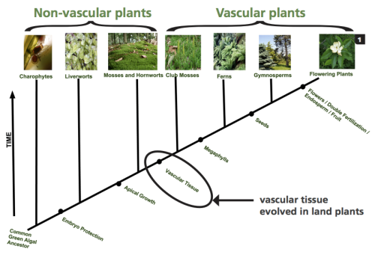
Thus, cladograms have an implied (relative) time scale. Any branching of the cladogram represents lineage divergence, the diversifi cation of lineages from one common ancestor.

Slide 4
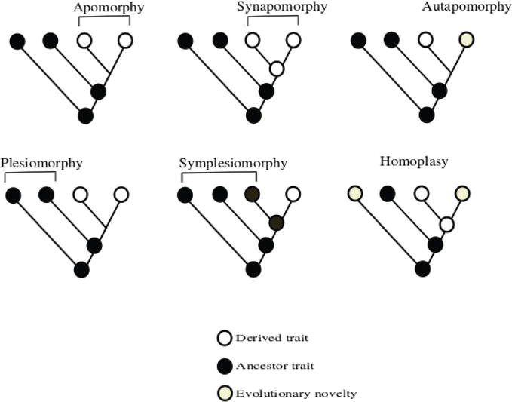
Apomorphy.
Evolution may be recognized as a change from a preexisting, or ancestral, character state to a new, derived character state. The derived character state is an evolutionary novelty, also called an apomorphy.
Phylogenetic systematics, or cladistics, is a methodology for inferring the pattern of evolutionary history of a group of organisms, utilizing these apomorphies

Slide 5
HOW TO CONSTRUCT CLADOGRAMS
Choose the taxa whose evolutionary relationships interest you. These taxa must be clades if you hope to come up with plausible results.
Determine the characters (features of the organisms) and examine each taxon to determine the character states (decide whether each taxon does or does not have each character). All taxa must be unique.

Slide 6
Determine the polarity of characters (whether each character state is original or derived in each taxon). Note that this step is not absolutely necessary in some computer algorithms. Examining the character states in outgroups to the taxa you are considering helps you determine the polarity.
Group taxa by synapomorphies (shared derived characteristics) not plesiomorphies (original, or "primitive", characteristics).
Work out conflicts that arise by some clearly stated method, usually parsimony (minimizing the number of conflicts).

Slide 7
Build your cladogram, which is NOT an evolutionary tree, following these rules:
All taxa go on the endpoints of the cladogram, never at nodes.
All cladogram nodes must have a list of synapomorphies which are common to all taxa above the node (unless the character is later modified).
All synapomorphies appear on the cladogram only once unless the character state was derived separately by evolutionary parallelism.

Slide 8
To accomplish the task of creating a good cladogram, you must use your judgement. Ask yourself the following questions and answer them carefully.
Could a supposed synapomorphy be the result of independent evolutionary development?
Are your characters chosen well?
Should you consider other characters?
Should you consider additional taxa?

Slide 9
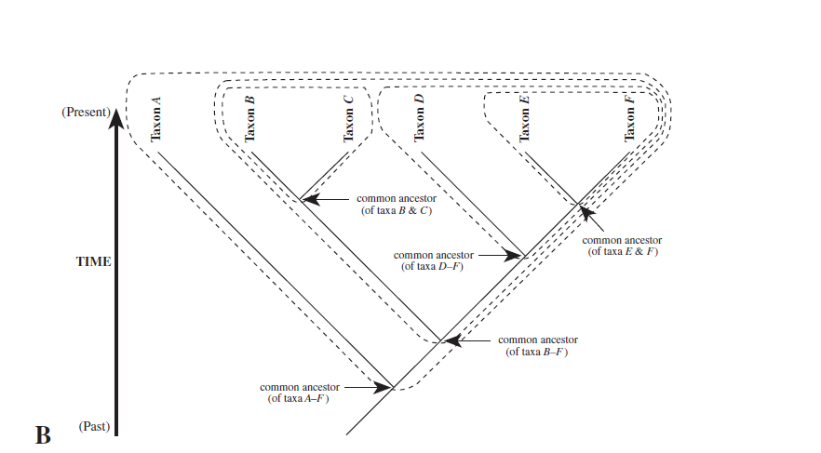
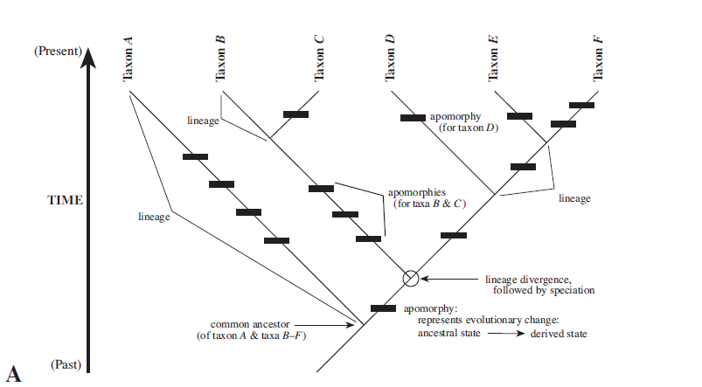
Example of a cladogram or phylogenetic tree for taxa A–F.
A. Cladogram showing lineages and apomorphies, the latter
indicated by thick hash marks.
B. Cladogram with common ancestors shown and monophyletic groups (clades) circled.

Slide 10
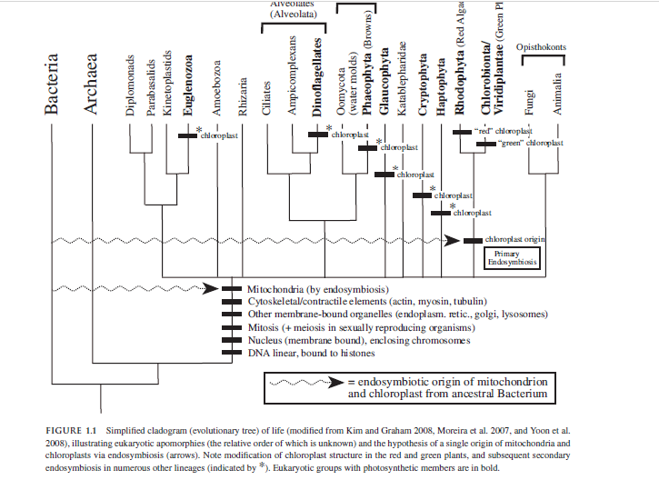

Slide 11
